Slide 1
Area of Triangles

Slide 2
From Last Lesson
How would a mathematician write the formula for area of a:
Square
Rectangle

Slide 3
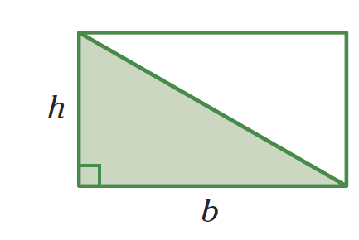
24
7
30
Area
Date
EQ – How do I find the area of triangles?
How do I find the area of a triangle?
https://www.geogebra.org/m/MyVgfMAg
We can think of a triangle as half of a rectangle.
How would a mathematician write that?
Area of a Triangle = ½ x Base x Height
A = ½ x B x H

Slide 4
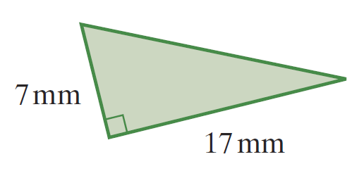
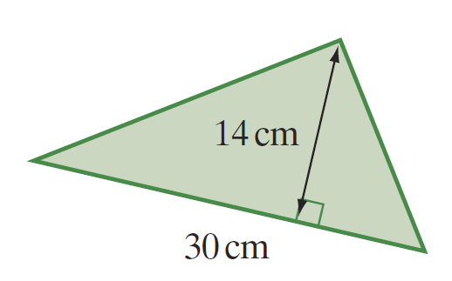
Practice

Slide 5


Slide 6
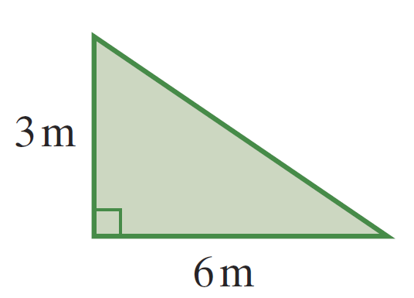
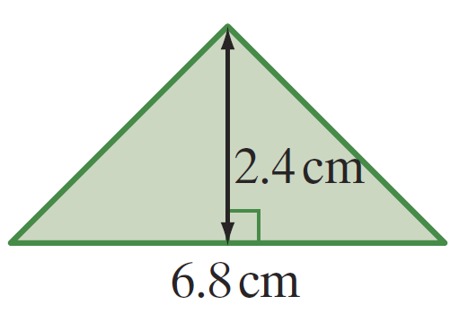
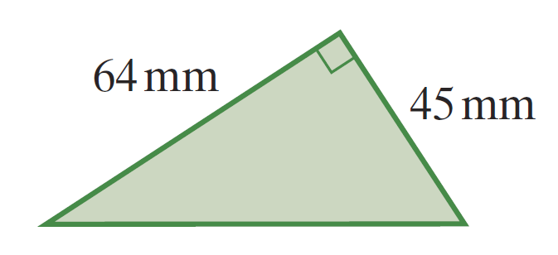
Task
1
2
3

